Slide 1
Unsupervised Learning
Dr. Sugata Ghosal
sugata.ghosal@pilani.bits-pilani.ac.in

Slide 2
Text Book(s)
T1 | Christopher Bishop: Pattern Recognition and Machine Learning, Springer International Edition
T2 | Tom M. Mitchell: Machine Learning, The McGraw-Hill Companies, Inc..
These slides are prepared by the instructor, with grateful acknowledgement of Prof. Bishop and many others who made their course materials freely available online.

Slide 3
Topics to be covered
Ref: Christopher Bishop: Chapter 9
Unsupervised learning
Clustering
K-means Clustering
Gaussian Mixture Models
EM algorithm

Slide 4
Unsupervised Learning
We only use the features X, not the labels Y
This is useful because we may not have any labels but we can still detect patterns
For example:
We can detect that news articles revolve around certain topics, and group them accordingly
Discover a distinct set of objects appear in a given environment, even if we don’t know their names, then ask humans to label each group
Identify health factors that correlate with a disease

Slide 6
What is clustering?
Grouping items that “belong together” (i.e. have similar features)

Slide 7
Feature representation (x)
A vector representing measurable characteristics of a data sample we have
E.g. a glass of juice can be represented via its color = {yellow=1, red=2, green=3, purple=4} and taste = {sweet=1, sour=2}
For a given glass i, this can be represented as a vector: xi = [3 2] represents sour green juice
For D features, this defines a D-dimensional space where we can measure similarity between samples

Slide 8



Feature representation (x)
2
taste
1
0
1
2
color
3
4

Slide 9
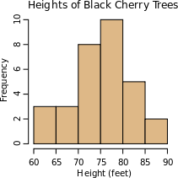
Why do we cluster?
Counting
Feature histograms: by grouping similar features and counting how many of each a data sample has
Summarizing data
Look at large amounts of data
– Represent a large continuous vector with the cluster number
Prediction
Data points in the same cluster may have the same labels
Ask a human to label the clusters
Slide credit: J. Hays, D. Hoiem

Slide 10
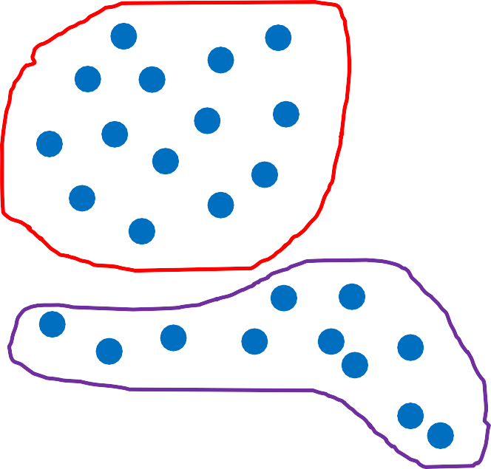



Two uses of clustering in one application
Why do we cluster?
Cluster, then ask human to label groups
Compute a histogram to summarize the data
1
“cat”
2
“panda”
Count in this sample
3
“giraffe”
Feature cluster
3d feature
2d feature

Slide 11

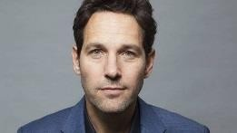
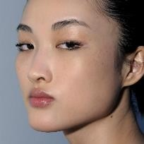
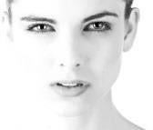

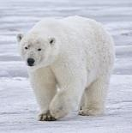
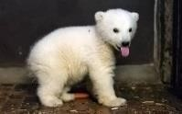
Unsupervised discovery

Slide 12
Clustering algorithms
In depth
K-means (iterate between finding centers and assigning points)
Gaussian Mixture Models (GMMs)

Slide 13

K-means Algorithm
Goal: represent a data set in terms of K clusters each of which is summarized by a prototype
Initialize prototypes, then iterate between two phases:
E-step: assign each data point to nearest prototype
M-step: update prototypes to be the cluster means
Simplest version is based on Euclidean distance
re-scale Old Faithful data

Slide 14
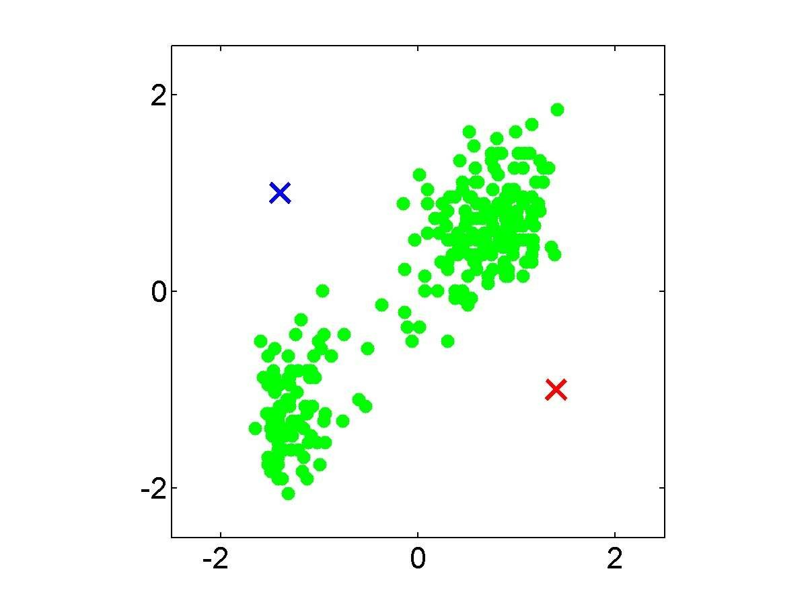

Slide 15
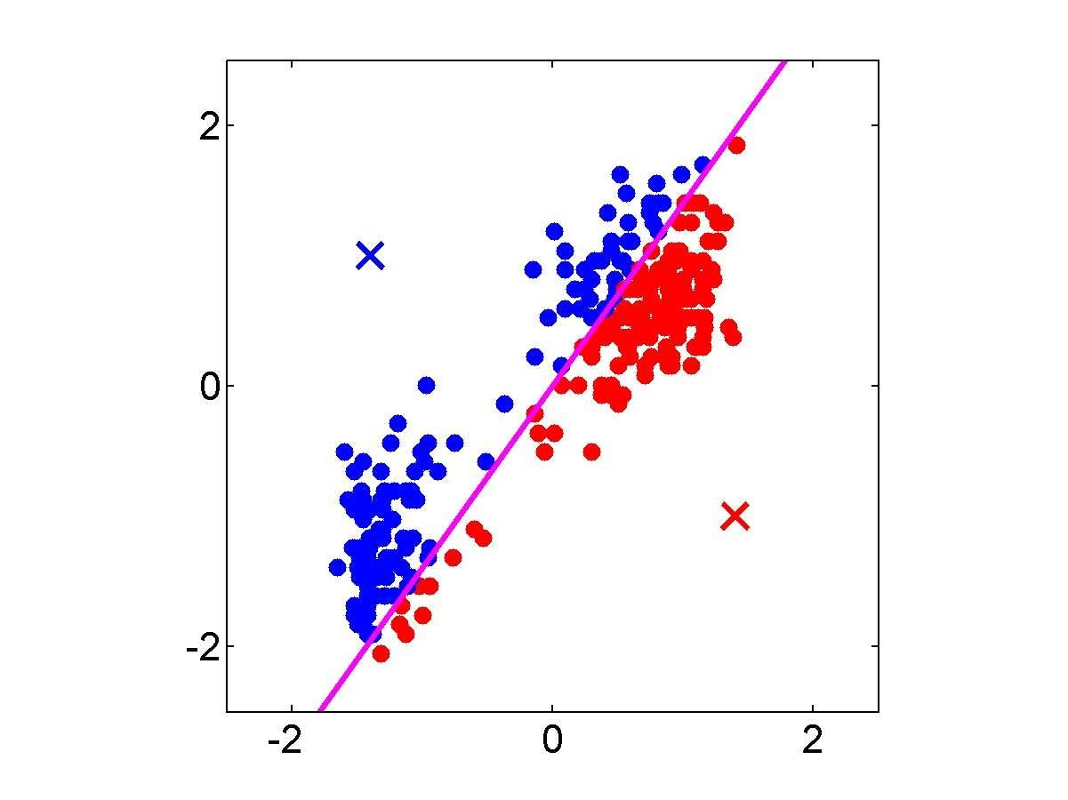

Slide 16
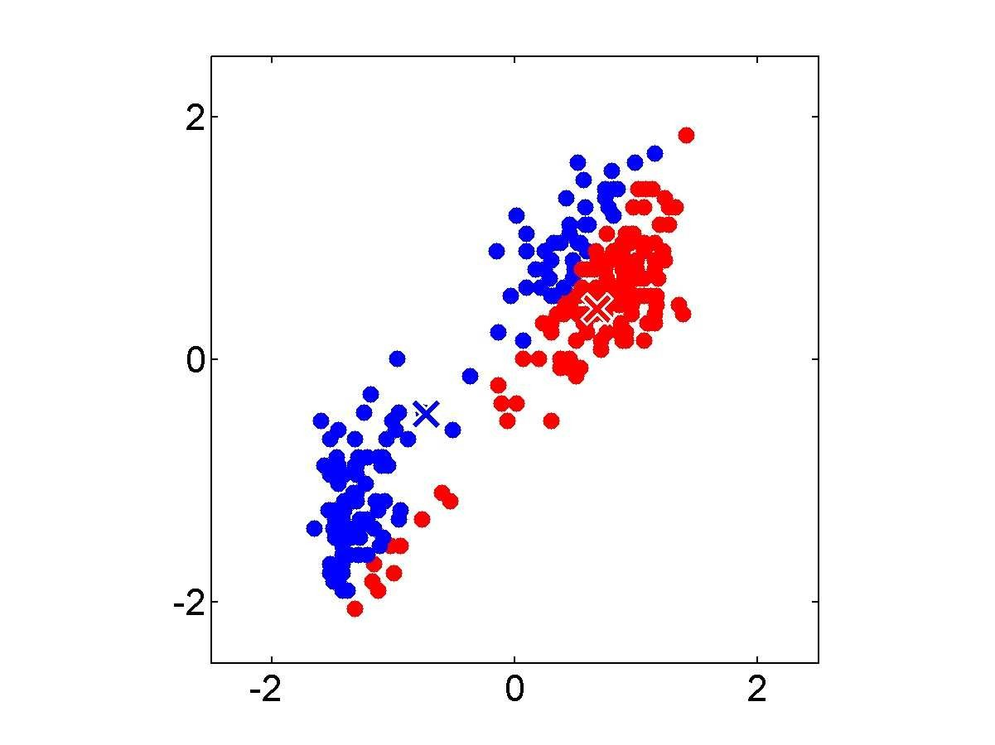

Slide 17
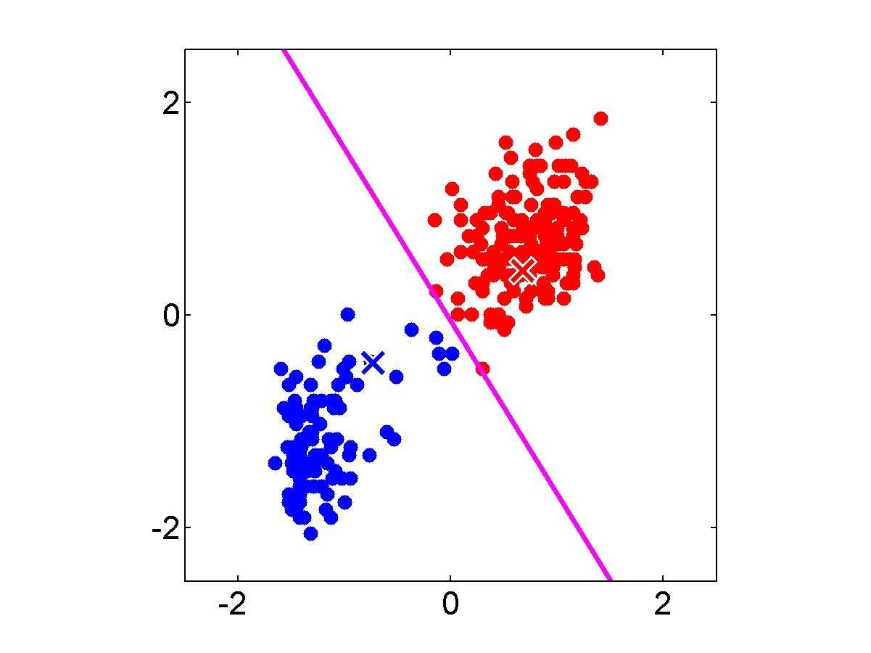

Slide 18


Slide 19
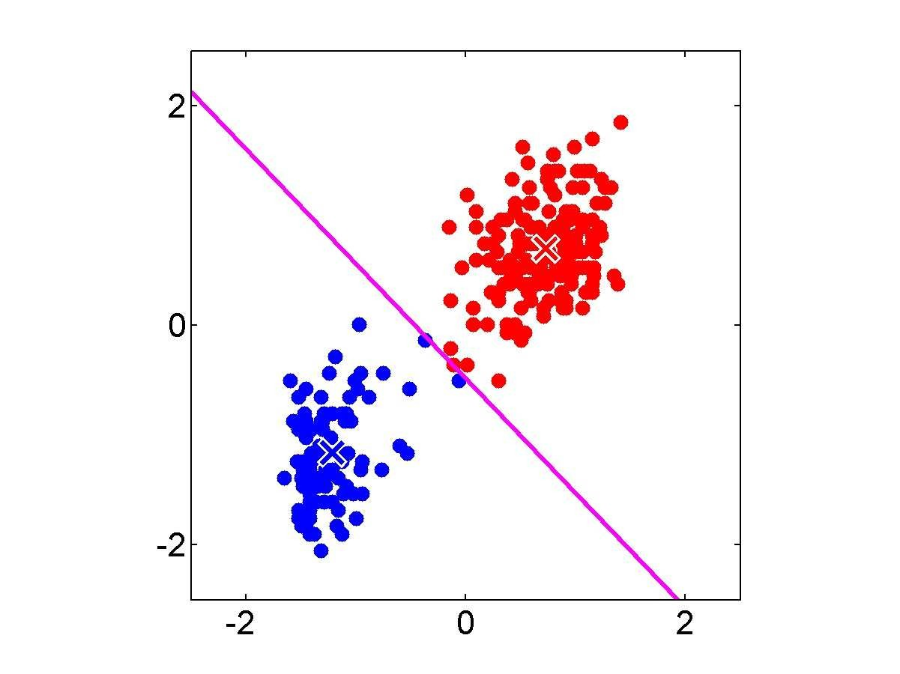

Slide 20


Slide 21


Slide 22


Slide 23
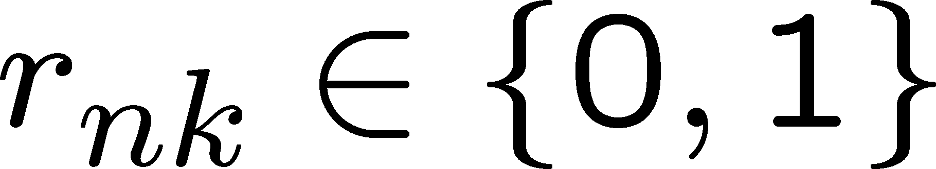
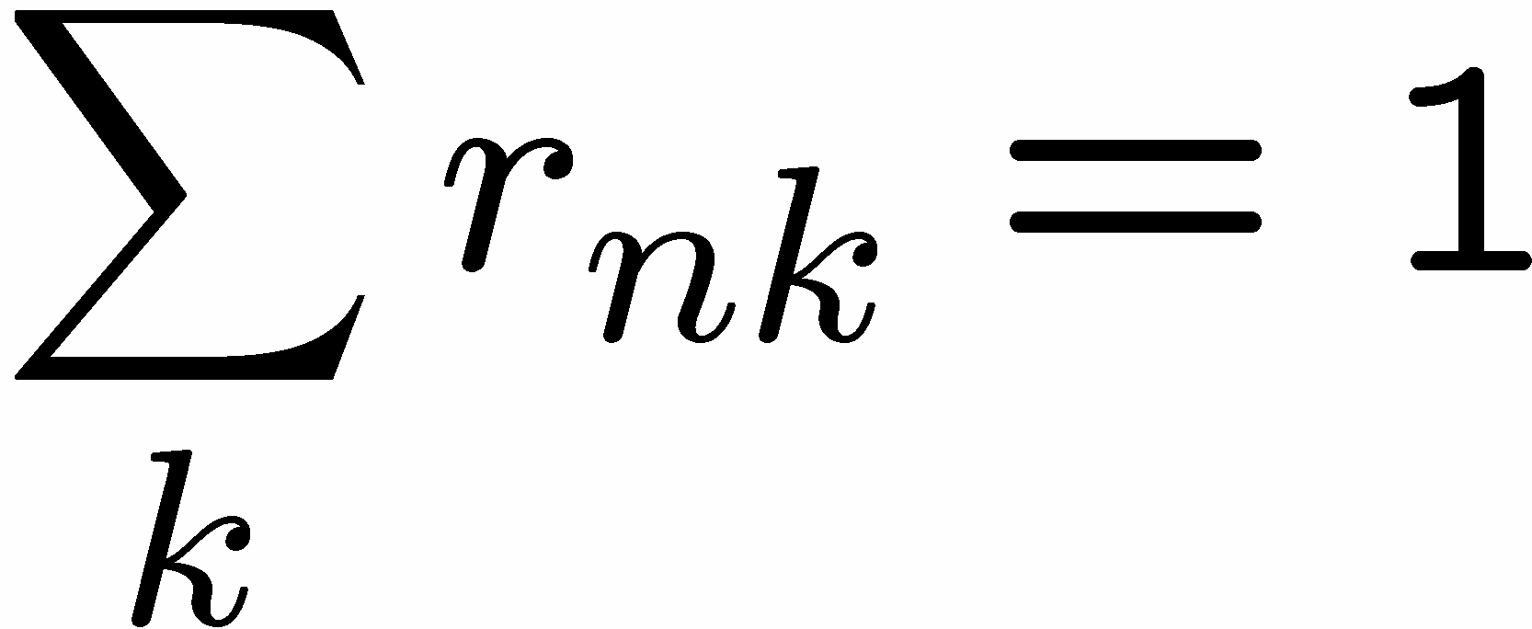
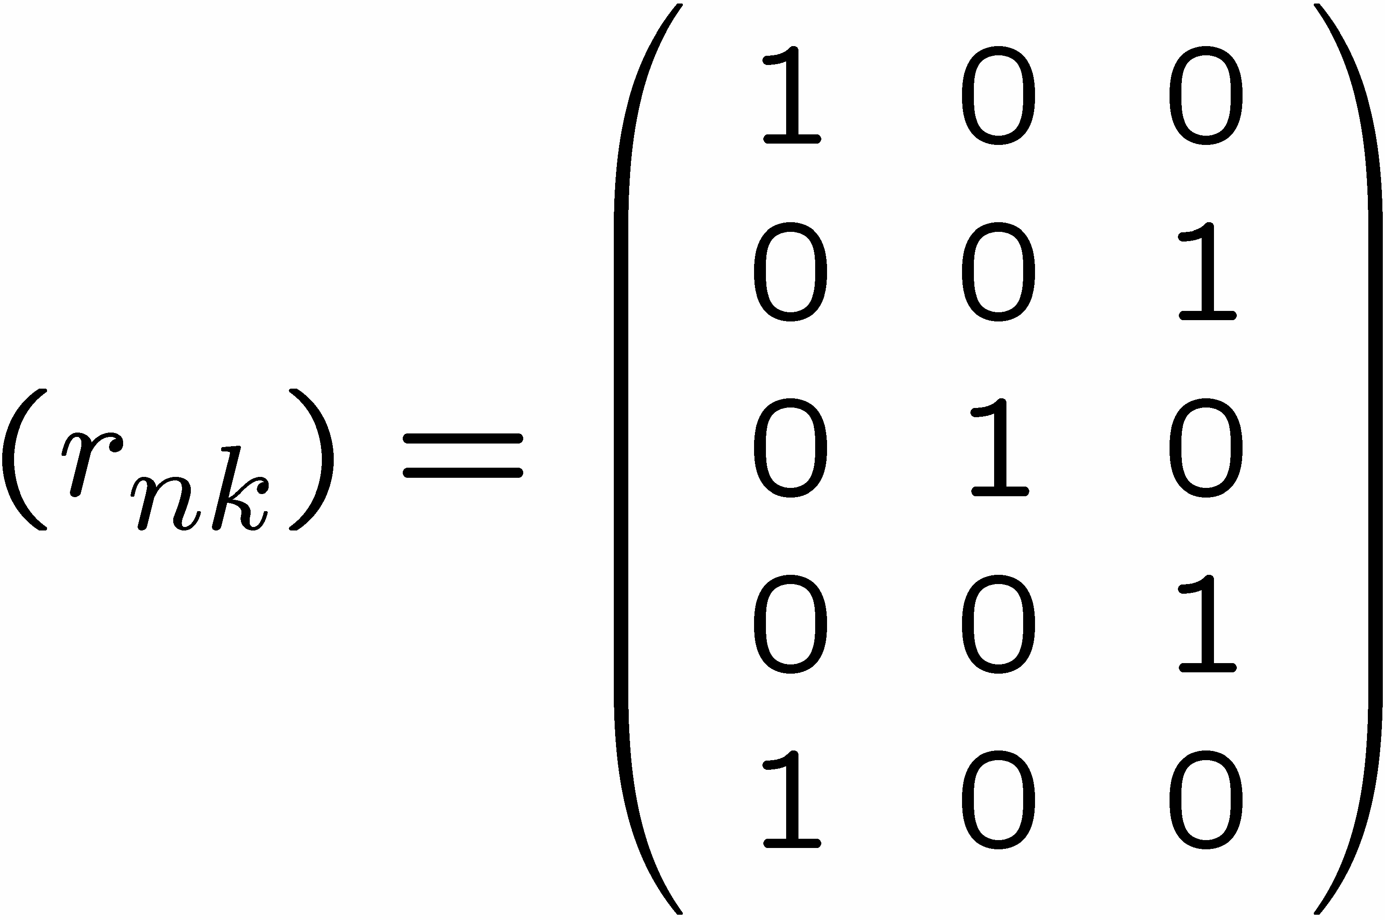
1 of K coding mechanism
For each data point x_{n}, we introduce a set of binary indicator variables
such that
where k =1,...,K describing which of the K clusters the data point x_{n} is assigned to, so that if data point x_{n} is assigned to cluster k then r_{nk} =1, and r_{nj} =0 for j not equal to k.
Example: 5 data points and 3 clusters

Slide 24
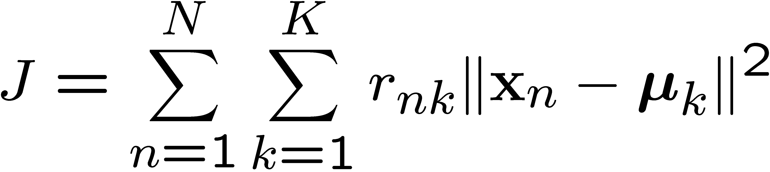
K-means Cost Function
data
responsibilities
prototypes

Slide 25










Minimizing the Cost Function
E-step: minimize J w.r.t.
M-step: minimize J w.r.t
Convergence guaranteed since there is a finite number of possible settings for the responsibilities

Slide 26
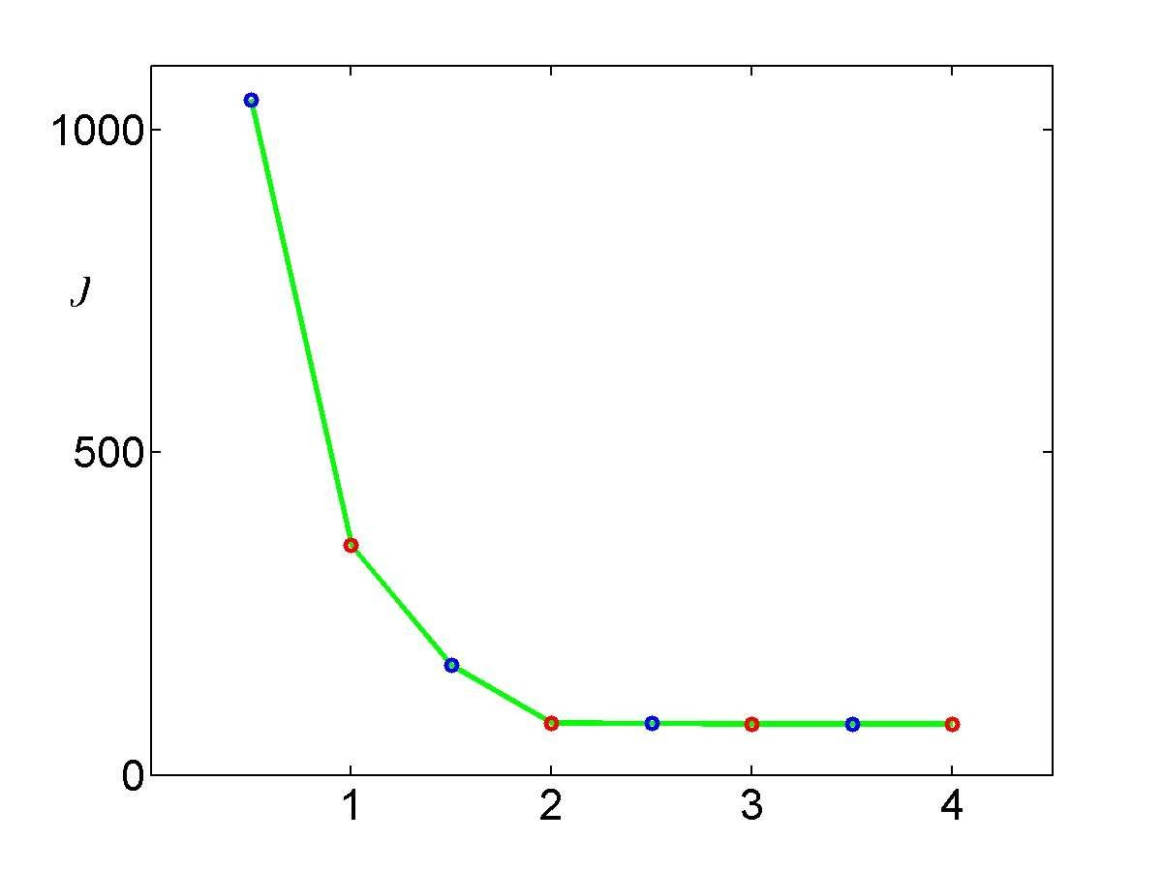

Slide 27
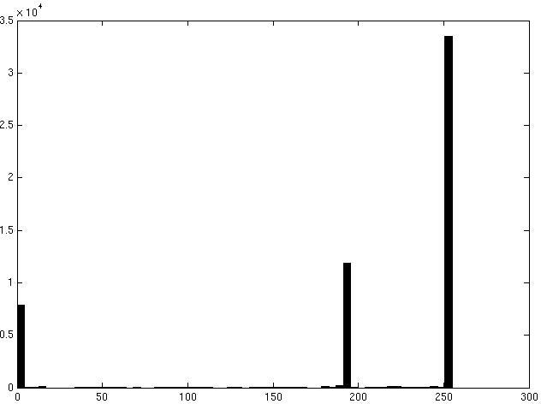

Image segmentation: toy example
white pixels
3
pixel count
black pixels
gray
pixels
1
2
input image
intensity
These intensities define the three groups.
We could label every pixel in the image according to which of these primary intensities it is.
i.e., segment the image based on the intensity feature.
What if the image isn’t quite so simple?
Source: K. Grauman

Slide 28

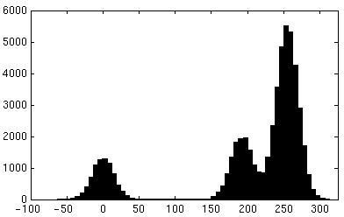
Now how to determine the three main intensities that define our groups?
We need to cluster.
input image
intensity
pixel count
pixel count
input image
intensity
Source: K. Grauman

Slide 29

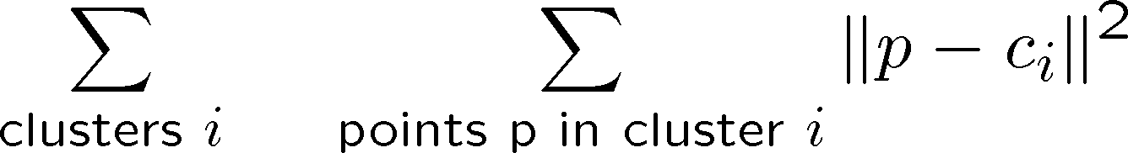
0
190
intensity
255
3
1
2
Goal: choose three “centers” as the representative intensities, and label every pixel according to which of these centers it is nearest to.
Best cluster centers are those that minimize SSD between all points and their nearest cluster center c_{i}:
Source: K. Grauman

Slide 30
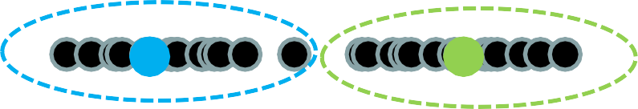
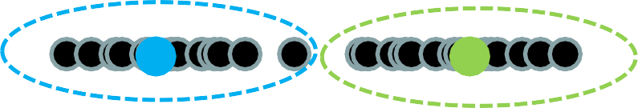

Clustering
With this objective, it is a “chicken and egg” problem:
– If we knew the cluster centers, we could allocate points to groups by assigning each to its closest center.
– If we knew the group memberships, we could get the centers by computing the mean per group.
Source: K. Grauman

Slide 31
K-means clustering
Basic idea: randomly initialize the k cluster centers, and iterate between the two steps we just saw.
Randomly initialize the cluster centers, c₁, ..., c_{K}
Given cluster centers, determine points in each cluster
For each point p, find the closest c_{i}. Put p into cluster i
Given points in each cluster, solve for c_{i}
Set c_{i} to be the mean of points in cluster i
If c_{i} have changed, repeat Step 2
Properties
Will always converge to some solution
Can be a “local minimum” of objective:
Slide: Steve Seitz, image: Wikipedia

Slide 32
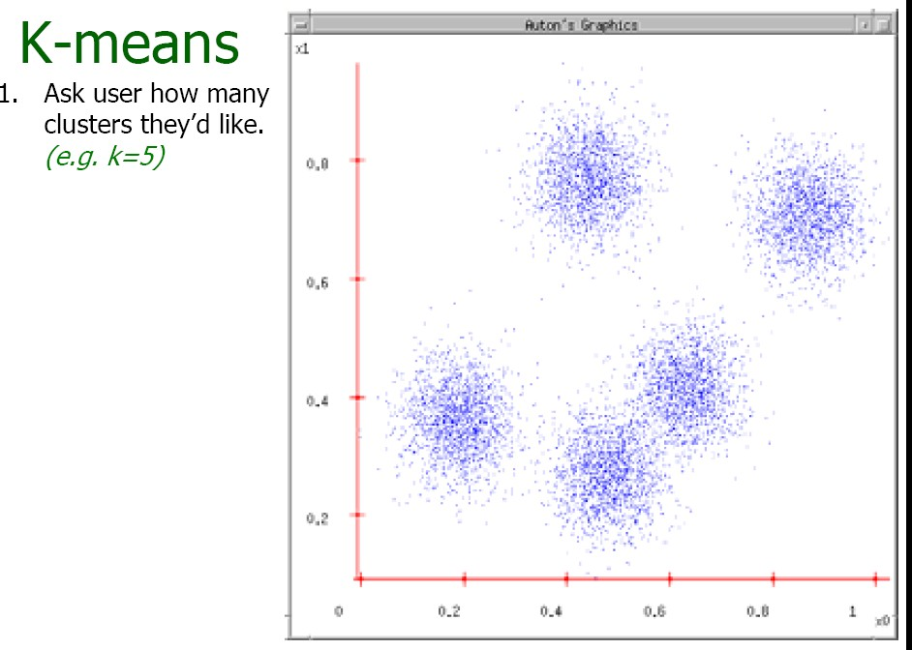
Source: A. Moore

Slide 33
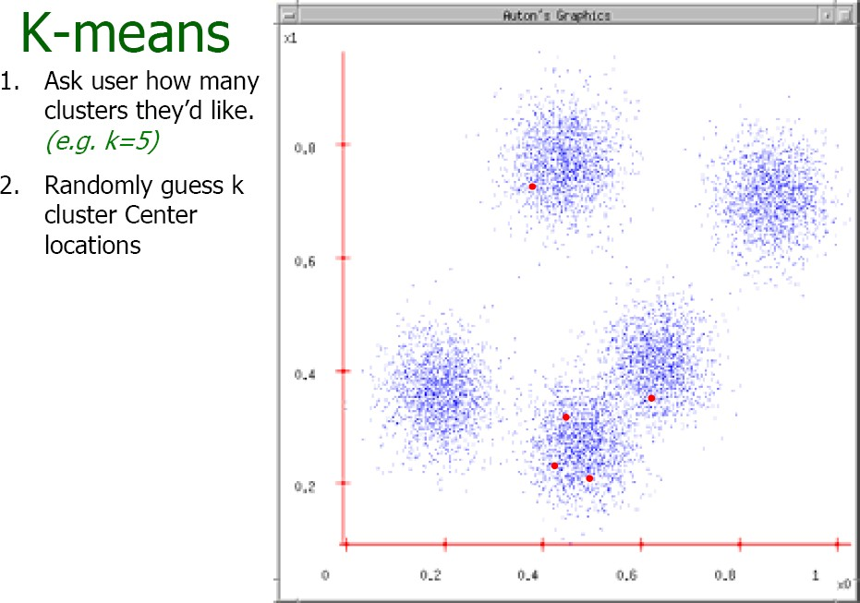
Source: A. Moore

Slide 34
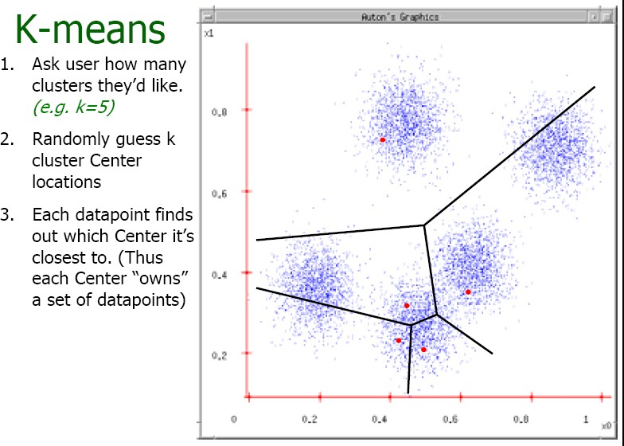
Source: A. Moore

Slide 35
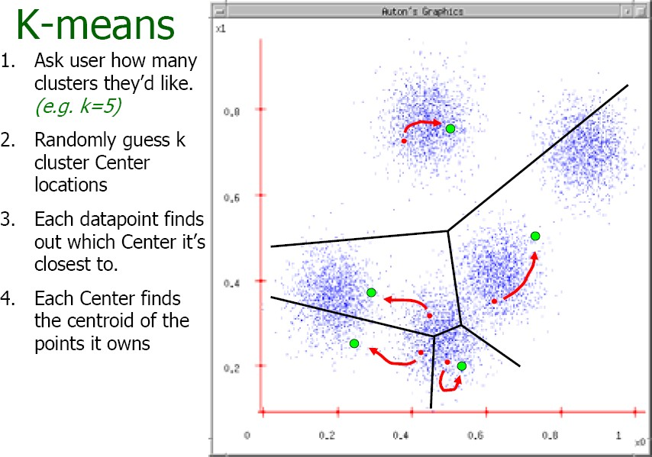
Source: A. Moore

Slide 36
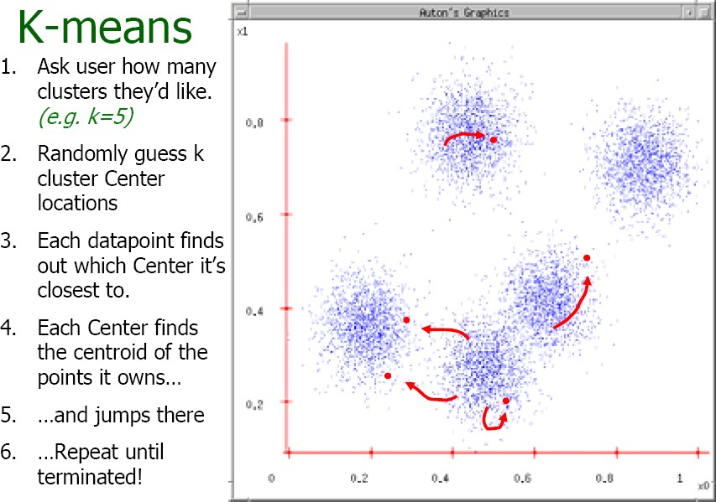
Source: A. Moore

Slide 37
K-means clustering
Visualization
https://www.naftaliharris.com/blog/visualizing-k-means-clustering/
Java demo
http://home.dei.polimi.it/matteucc/Clustering/tutorial_html/AppletKM.html
Matlab demo
http://www.cs.pitt.edu/~kovashka/cs1699_fa15/kmeans_demo.m

Slide 38
Time Complexity
Let n = number of instances, d = dimensionality of the features, k = number of clusters
Assume computing distance between two instances is O(d)
Reassigning clusters:
O(kn) distance computations, or O(knd)
Computing centroids:
Each instance vector gets added once to a centroid: O(nd)
Assume these two steps are each done once for a fixed number of iterations I: O(Iknd)
Linear in all relevant factors
Adapted from Ray Mooney

Slide 39
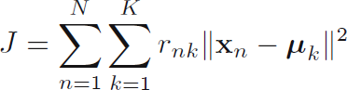
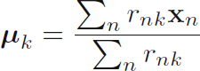
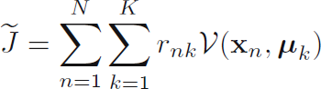
Another way of writing objective
K-means:
Let r_{nk} = 1 if instance n belongs to cluster k, 0 otherwise
k-means the centre of a cluster is not necessarily one of the input data points (it is the average between the points in the cluster).
K-medoids (more general distances):
k-medoids chooses data points as centers (medoids or exemplars) and can be used with arbitrary distances
k-medoids more robust to noise and outliers as compared to k-means because it minimizes a sum of pairwise dissimilarities instead of a sum of squared Euclidean distances.

Slide 40
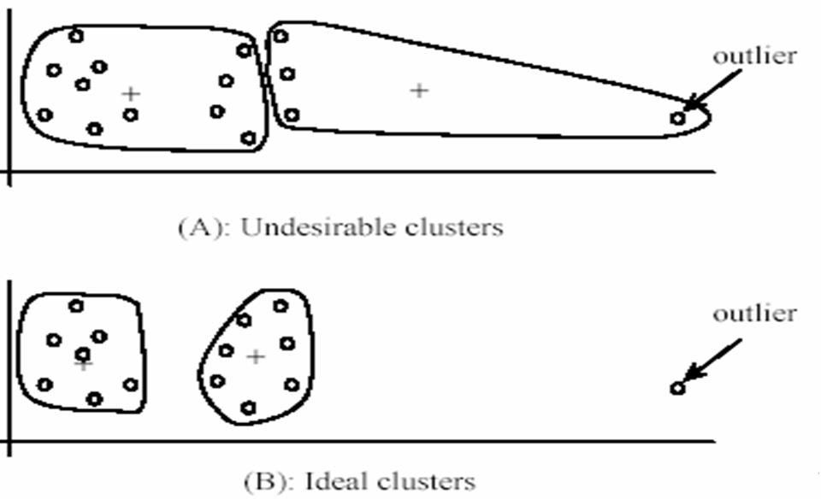
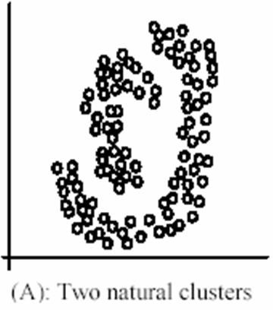
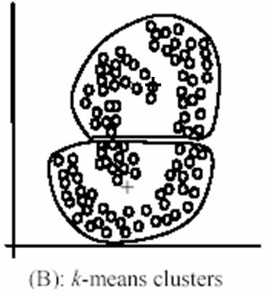
K-means: pros and cons
Pros
Simple, fast to compute
Converges to local minimum of
within-cluster squared error
Cons/issues
Setting k?
Sensitive to initial centers
Use heuristics or output of another method
Sensitive to outliers
Detects spherical clusters
Adapted from K. Grauman

Slide 41
Probabilistic Clustering
Represent the probability distribution of
the data as a mixture model
captures uncertainty in cluster assignments
gives model for data distribution
Bayesian mixture model allows us to determine K
Consider mixtures of Gaussians

Slide 42
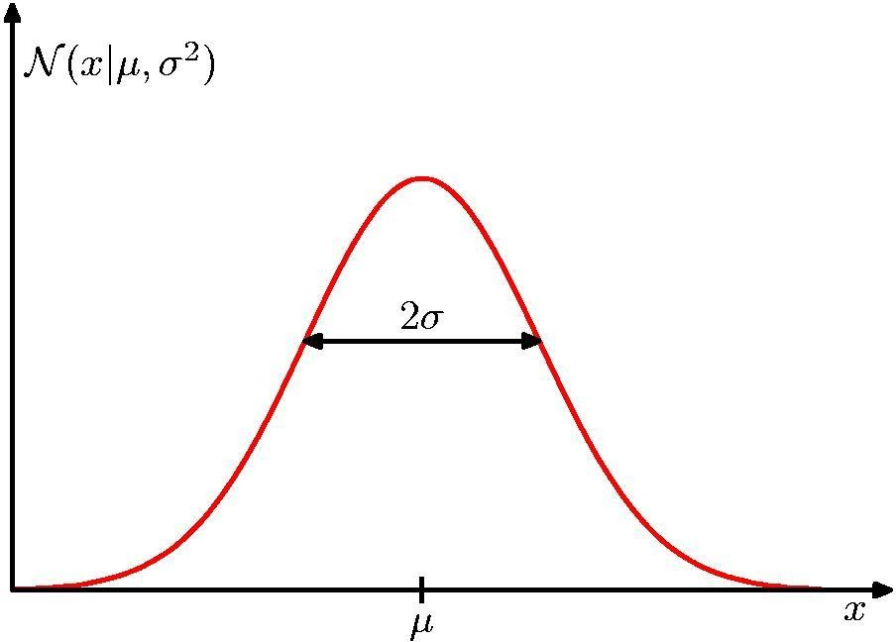
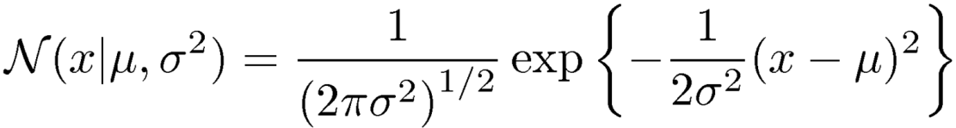
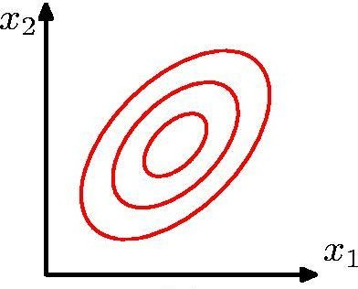
Review: Gaussian Distribution
Chris Bishop

Slide 43



The Gaussian Distribution
Multivariate Gaussian
mean
covariance
x
2
x
2
x
2
x
1
x
1
x
1
(a)
(b)
(c)

Slide 44
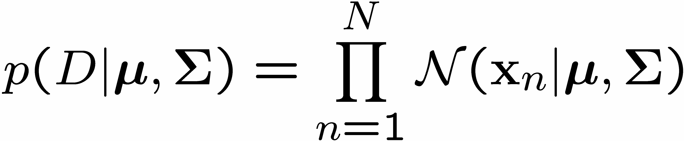
Data set
Consider first a single Gaussian
Assume observed data points generated independently
Viewed as a function of the parameters, this is known as the likelihood function

Slide 45
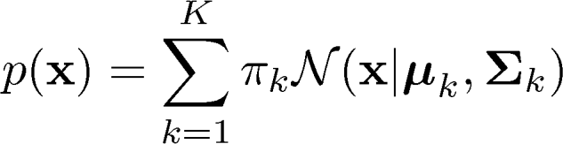
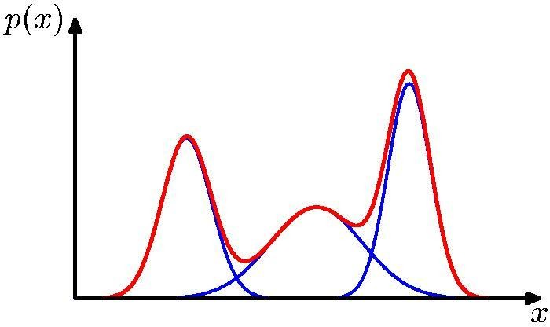
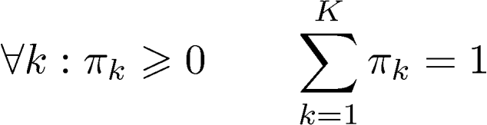
Mixtures of Gaussians
Combine simple models into a complex model:
Component Mixing coefficient
K=3
Find parameters through EM (Expectation Maximization) algorithm
Adapted from Chris Bishop

Slide 46

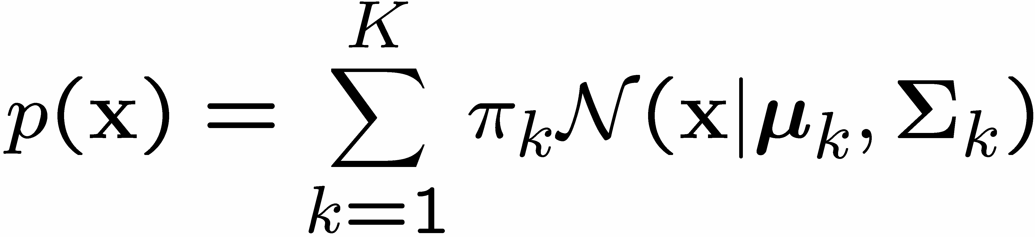

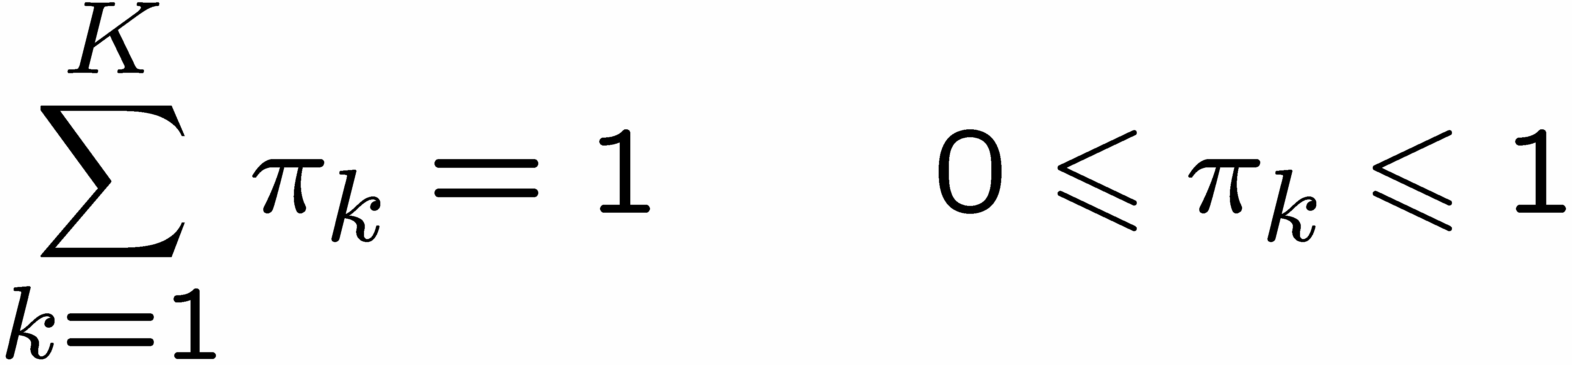
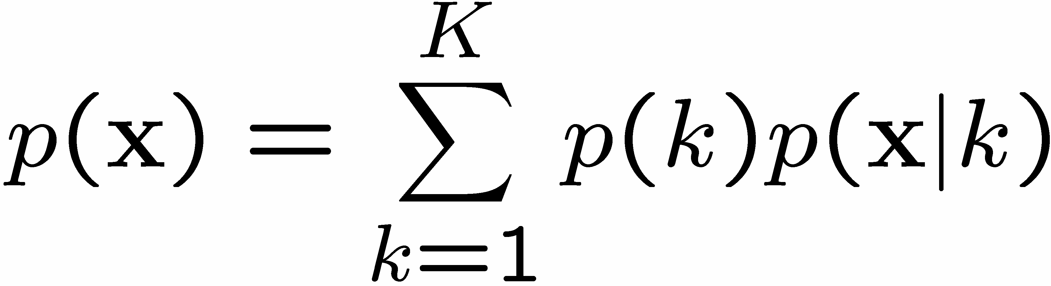
Gaussian Mixture Model
Linear super-position of Gaussians
Normalization and positivity require
Can interpret the mixing coefficients as prior probabilities

Slide 47
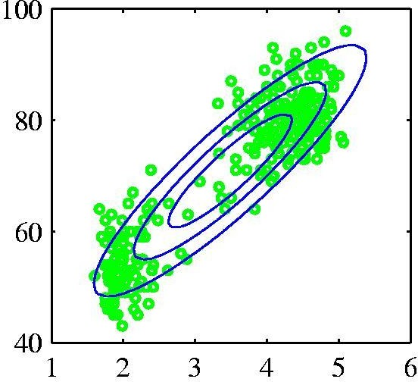
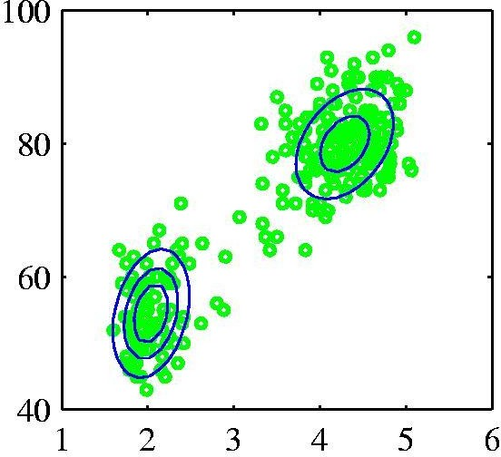
Probabilistic version: Mixtures of Gaussians
Old Faithful data set
Single Gaussian
Mixture of two
Gaussians
Chris Bishop

Slide 48
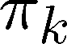
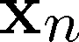
Sampling from the Mixture of Gaussian
To generate a data point:
first pick one of the components with probability
then draw a sample from that component
Repeat these two steps for each new data point

Slide 49
Fitting the Gaussian Mixture
We wish to invert this process – given the data set, find the corresponding parameters:
mixing coefficients
means
covariances
If we knew which component generated each data point, the maximum likelihood solution would involve fitting each component to the corresponding cluster
Problem: the data set is unlabelled
We shall refer to the labels as latent (= hidden) variables

Slide 50
Gaussian Mixture Model
K-dimensional binary random variable z having a 1-of-K representation in which a particular element z_{k} is equal to 1 and all other elements are equal to 0.
The values of z_{k} therefore satisfy z_{k} ∈{ 0,1}
K possible states for the vector z according to which element is nonzero.
Joint distribution p(x,z) in terms of a marginal distribution p(z) and a conditional distribution p(x|z),
Marginal distribution over z is speciﬁed in terms of the mixing coefﬁcients π_{k}, such that p(z_{k} = 1) =π_{k}

Slide 51
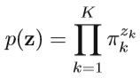
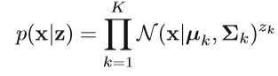
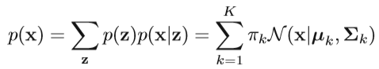
Gaussian Mixture Model
z uses a 1-of-K representation, we can also write this distribution in the form
Joint distribution is given by p(z)p(x|z), and the marginal distribution of x is then obtained by summing the joint distribution over all possible states of z to given
Conditional distribution of x given a particular value for z is a Gaussian

Slide 52

Gaussian Mixture Model
Conditional probability of z given x
use γ(z_{k}) to denote p(z_{k} =1 | x), whose value can be found using Bayes’ theorem
π_{k} as the prior probability of z_{k} =1, and the quantity γ(z_{k}) as the corresponding posterior probability once we have observed x.

Slide 53

Maximum Likelihood
Log of likelihood function:
Maximizing the log likelihood function for a Gaussian mixture model turns out to be a more complex problem than for the case of a single Gaussian.
The difﬁculty arises from the presence of the summation over k that appears inside the logarithm, so that the logarithm function no longer acts directly on the Gaussian.

Slide 54
EM Algorithm – Informal Derivation
The solutions are not closed form since they are coupled
Suggests an iterative scheme for solving them:
make initial guesses for the parameters
alternate between the following two stages:
E-step: evaluate responsibilities
M-step: update parameters using ML results
Each EM cycle guaranteed not to decrease the likelihood

Slide 55



Expectation Maximization (EM)
Algorithm
Conditions for MLE: Setting the derivatives of ln p(X|π,µ,Σ)
in with respect to the means µk of the Gaussian components to zero, we obtain
rearranging we obtain:
where we have deﬁned

Slide 56

Expectation Maximization (EM)
Algorithm
µ_{k} for the kth Gaussian component is obtained by taking a weighted mean of all of the points in the data set
Weighting factor for data point x_{n} is given by the posterior probability γ(z_{nk}) that component k was responsible for generating xn
If we set the derivative of ln p(X|π,µ,Σ) with respect to Σk to 0, and follow a similar line of reasoning, making use of the result for the maximum likelihood solution for the covariance matrix of a single Gaussian

Slide 57



Expectation Maximization (EM)
Algorithm
Maximize ln p(X|π,µ,Σ) with respect to the mixing coefﬁcients π_{k} with constraint
Using a Lagrange multiplier and maximizing the following quantity
which gives
If we now multiply both sides by πk and sum over k, we ﬁnd λ = −N.
Rearranging we obtain

Slide 58
Expectation Maximization (EM)
Algorithm
We ﬁrst choose some initial values for the means, covariances, and mixing coefﬁcients.
Then we alternate between the following two updates that we shall call the E step and the M step
In the expectation step, or E step, we use the current values for the parameters to evaluate the posterior probabilities,
We then use these probabilities in the maximization step, or M step, to re-estimate the means, covariances, and mixing
In practice, the algorithm is deemed to have converged when the change in the log likelihood function, or alternatively in the parameters, falls below some threshold

Slide 59

Initialization
E step
M step
Figures from Chris Bishop

Slide 60
Example: Mixture of 3 Gaussians
1
0.5
0
0
0.5
1
(a)

Slide 61
Contours of Probability Distribution
1
0.5
0
0
0.5
1
(b)

Slide 62

Surface Plot

Slide 63

Synthetic Data Set
1
0.5
0
0
0.5
1
(a)

Slide 64

Synthetic Data Set Without Labels
1
0.5
0
0
0.5
1
(b)

Slide 65


Posterior Probabilities
We can think of the mixing coefficients as prior probabilities for the components
For a given value of we can evaluate the corresponding posterior probabilities, called responsibilities
These are given from Bayes’ theorem by

Slide 66

Posterior Probabilities (colour coded)
1
0.5
0
0
0.5
1
(a)

Slide 67

EM algorithm for GMM
Initialize the means µ_{k}, covariances Σ_{k} and mixing coefﬁcients π_{k}, and evaluate the initial value of the log likelihood.
E step: Evaluate the responsibilities using the current parameter values

Slide 68



EM algorithm for GMM
3. M step: Re-estimate the parameters using the current responsibilities
where
4. Evaluate the log likelihood

Slide 69




Over-fitting in Gaussian Mixture Models
Singularities in likelihood function when a component ‘collapses’ onto a data point:
then consider
Likelihood function gets larger as we add more components (and hence parameters) to the model
– not clear how to choose the number K of components

Slide 70


Π₁ = Π₂ = 0.5

Slide 71

N(xi|μ1)
N(xi|μ2)
N(xi|μ1)+N(xi|μ2)
γ(zi,1)
γ(zi,2)

Slide 72

Segmentation as clustering
Depending on what we choose as the feature space, we
can group pixels in different ways.
Grouping pixels based on intensity similarity
Feature space: intensity value (1-d)
Source: K. Grauman

Slide 73


K=2
K=3
quantization of the feature space; segmentation label map
Source: K. Grauman

Slide 74





Segmentation as clustering
Depending on what we choose as the feature space, we
can group pixels in different ways.
R=255
Grouping pixels based on color similarity
G=200 B=250
B
R=245 G=220 B=248
G
R=15 G=189 B=2
R=3 G=12 B=2
R
Feature space: color value (3-d)
Source: K. Grauman

Slide 75

Application: Face Recognition
Image from cnet.com

Slide 76
References
Christopher Bishop: Pattern Recognition and Machine Learning, Springer International Edition
https://www.youtube.com/watch?v=TG6Bh-NFhA0
https://www.youtube.com/watch?v=qMTuMa86NzU

